Slide 1
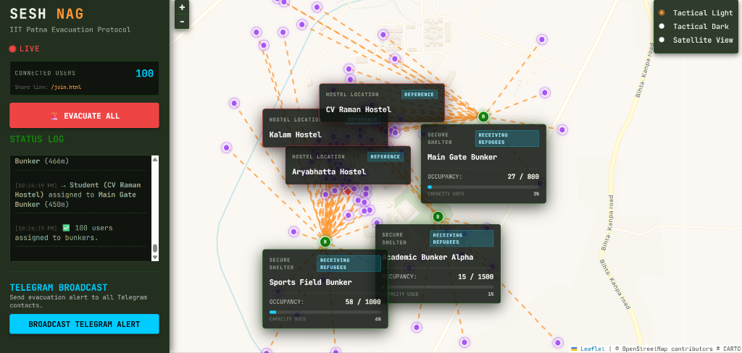
● LIVE STATUS | SESHNAG EVACUATION COMMAND CENTER
Campus Evacuation Protocol
TACTICAL FEATURES & SYSTEM OVERVIEW
■ Real-Time GPS Tracking
Synchronizes live coordinate telemetry from user devices and simulated campus civilians directly onto a command-map interface.
■ Dynamic Suitability Allocation
Distributes evacuees automatically using Haversine distance and bunker structural strength algorithms to balance shelter load.
■ Telegram Notification Broadcast
Pushes instant coordinate directives and emergency alerts to refugees' devices with a single command click.
UPLINK STATUS: 100 CONNECTED USERS | BUNKER ALLOCATION RATIO: OPTIMAL | PROTOCOL VERSION: 1.0.4

